Slide 1
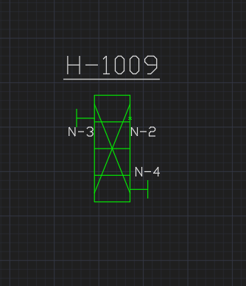
E04V01 Heat Exchanger with Nozzles

